Slide 1
Amazon ElastiCache
Dr. Noman Islam

Slide 2
Introduction
By using the Amazon ElastiCache service, you can offload the heavy lifting involved in the deployment and operation of cache environments running Memcached or Redis.
Research has shown that users will get frustrated and leave a website or app when it is slow to respond
Round-trips back and forth to a database and its underlying storage can add significant delays and are often the top contributor to application latency.

Slide 3
By storing or moving frequently accessed data in-memory, application developers can significantly improve the performance and responsiveness of read-heavy applications
For example, the application session state for a large website can be stored in an in-memory caching engine, instead of storing the session data in the database.

Slide 4
Memcache and Redis
For many years, developers have been building applications that use cache engines like Memcached or Redis to store data in-memory to get blazing fast application performance
Memcached is a simple-to-use in-memory key/value store that can be used to store arbitrary types of data.
It is one of the most popular cache engines.
Redis is a flexible in-memory data structure store that can be used as a cache, database, or even as a message broker.
Amazon ElastiCache allows developers to easily deploy and manage cache environments running either Memcached or Redis.

Slide 5
Amazon ElastiCache
Amazon ElastiCache is a web service that simplifies the setup and management of distributed in-memory caching environments.
With Amazon ElastiCache, you can choose from a Memcached or Redis protocol-compliant cache engine and quickly launch a cluster within minutes

Slide 6
Caching patterns
Using Amazon ElastiCache, you can implement any number of caching patterns.
The most common pattern is the cache-aside pattern
In this scenario, the app server checks the cache first to see if it contains the data it needs.
If the data does not exist in the cache node, it will query the database and serialize and write the query results to the cache.
The next user request will then be able to read the data directly from the cache instead of querying the database.

Slide 7
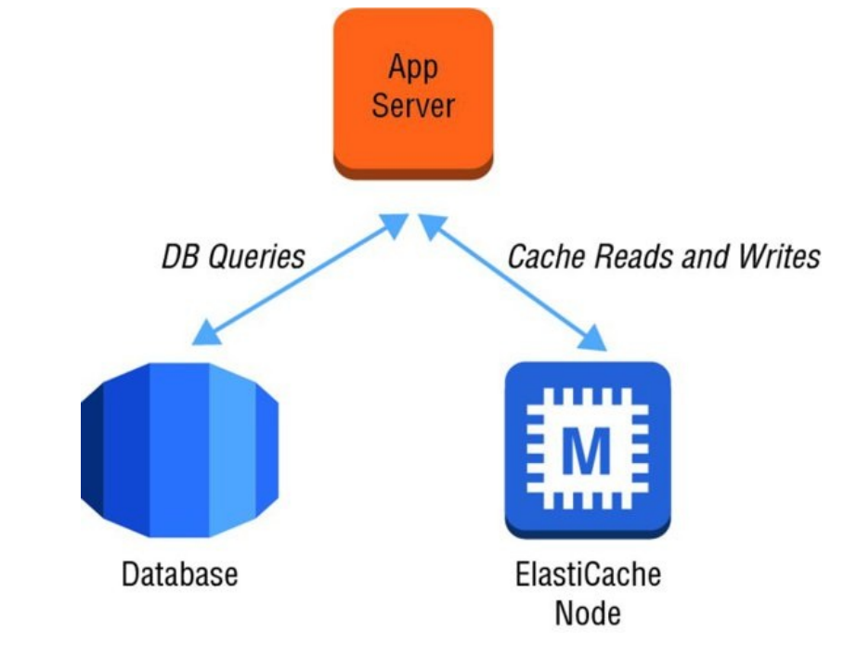

Slide 8
Why ElasticCache
Amazon ElastiCache allows you to offload the heavy lifting of installation, patch management, and monitoring to AWS so you can focus on your application instead
Amazon ElastiCache can automatically detect and recover from the failure of a cache node.
With the Redis engine, Amazon ElastiCache makes it easy to set up read replicas and fail over from the primary to a replica in the event of a problem

Slide 9
Cache Engines
Memcached Memcached provides a very simple interface that allows you to write and read objects into in-memory key/value data stores.
With Amazon ElastiCache, you can elastically grow and shrink a cluster of Memcached nodes to meet your demands.
You can partition your cluster into shards and support parallelized operations for very high performance throughput.
Memcached deals with objects as blobs that can be retrieved using a unique key

Slide 10
Unlike Memcached, Redis supports the ability to persist the in-memory data onto disk.
This allows you to create snapshots that back up your data and then recover or replicate from the backups.
Redis clusters also can support up to five read replicas to offload read requests.
In the event of failure of the primary node, a read replica can be promoted and become the new master using Multi-AZ replication groups.

Slide 11
Nodes and Clusters
Each deployment of Amazon ElastiCache consists of one or more nodes in a cluster
A single Memcached cluster can contain up to 20 nodes.
Redis clusters are always made up of a single node; however, multiple clusters can be grouped into a Redis replication group

Slide 12
Memcached Auto Discovery
For Memcached clusters partitioned across multiple nodes, Amazon ElastiCache supports Auto Discovery with the provided client library.
Auto Discovery simplifies your application code by no longer needing awareness of the infrastructure topology of the cache cluster in your application layer.

Slide 13
Scaling
Amazon ElastiCache allows you to adjust the size of your environment to meet the needs of workloads as they evolve over time
Amazon ElastiCache also adds additional functionality that allows you to scale horizontally the size of your cache environment.
This functionality differs depending on the cache engine you have selected.
With Memcached, you can partition your data and scale horizontally to 20 nodes or more.
With Auto Discovery, your application can discover Memcached nodes that are added or removed from a cluster.

Slide 14
Vertical Scaling Support for vertical scaling is more limited with Amazon ElastiCache.
If you like to change the cache node type and scale the compute resources vertically, the service does not directly allow you to resize your cluster in this manner

Slide 15
Backup and Recovery
Amazon ElastiCache clusters running Redis allow you to persist your data from in-memory to disk and create a snapshot
Each snapshot is a full clone of the data that can be used to recover to a specific point in time or to create a copy for other purposes.
Snapshots cannot be created for clusters using the Memcached engine because it is a purely in-memory key/value store and always starts empty.

Slide 16
Access Control
Access to your Amazon ElastiCache cluster is controlled primarily by restricting inbound network access to your cluster.
Inbound network traffic is restricted through the use of security groups.
Each security group defines one or more inbound rules that restrict the source traffic

